Slide 1
S3 Integration with Databricks using Unity Catalog External Locations

Slide 2
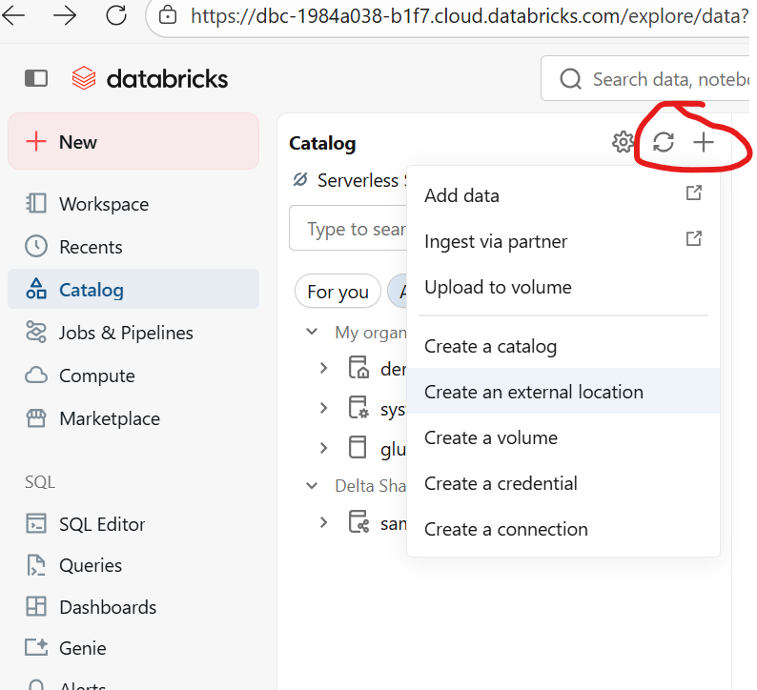

Slide 3
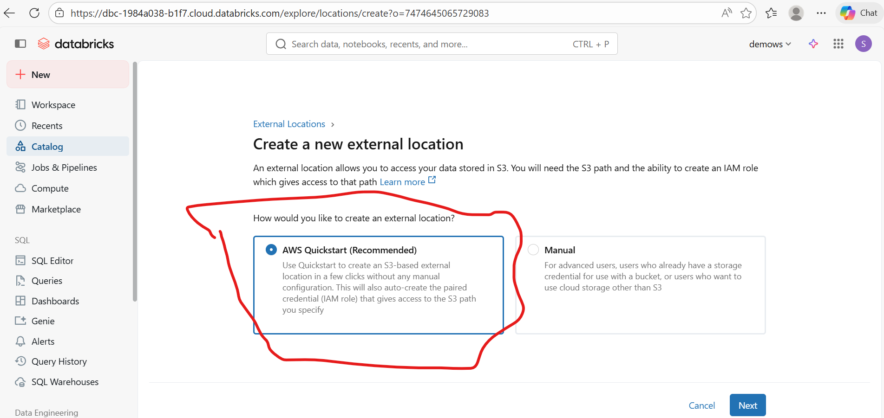

Slide 4
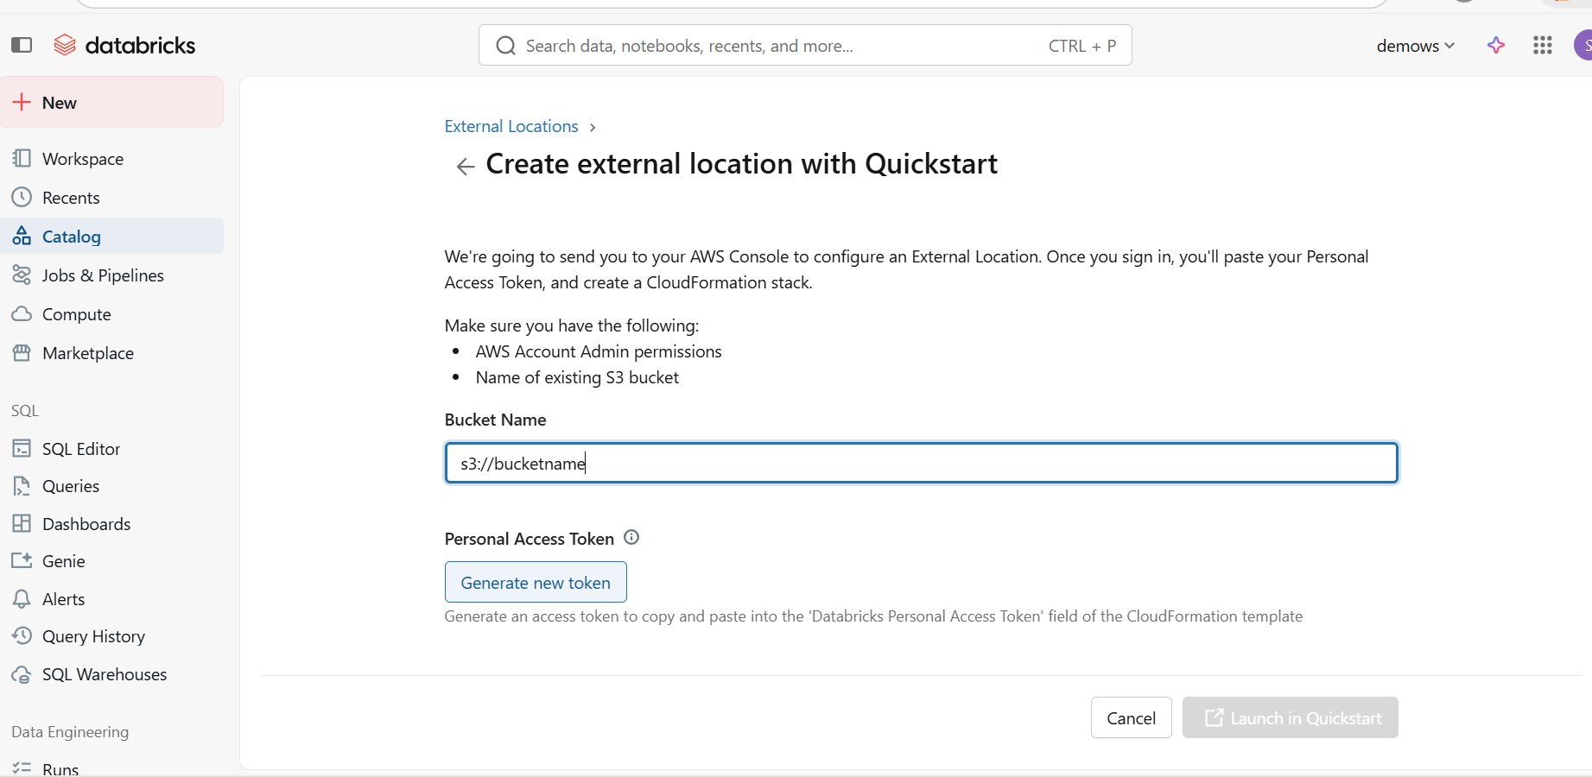
Provide Bucket name and generate token

Slide 5
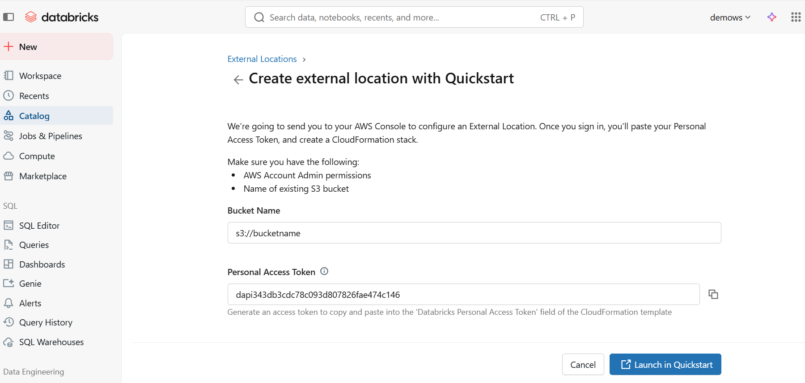

Slide 6
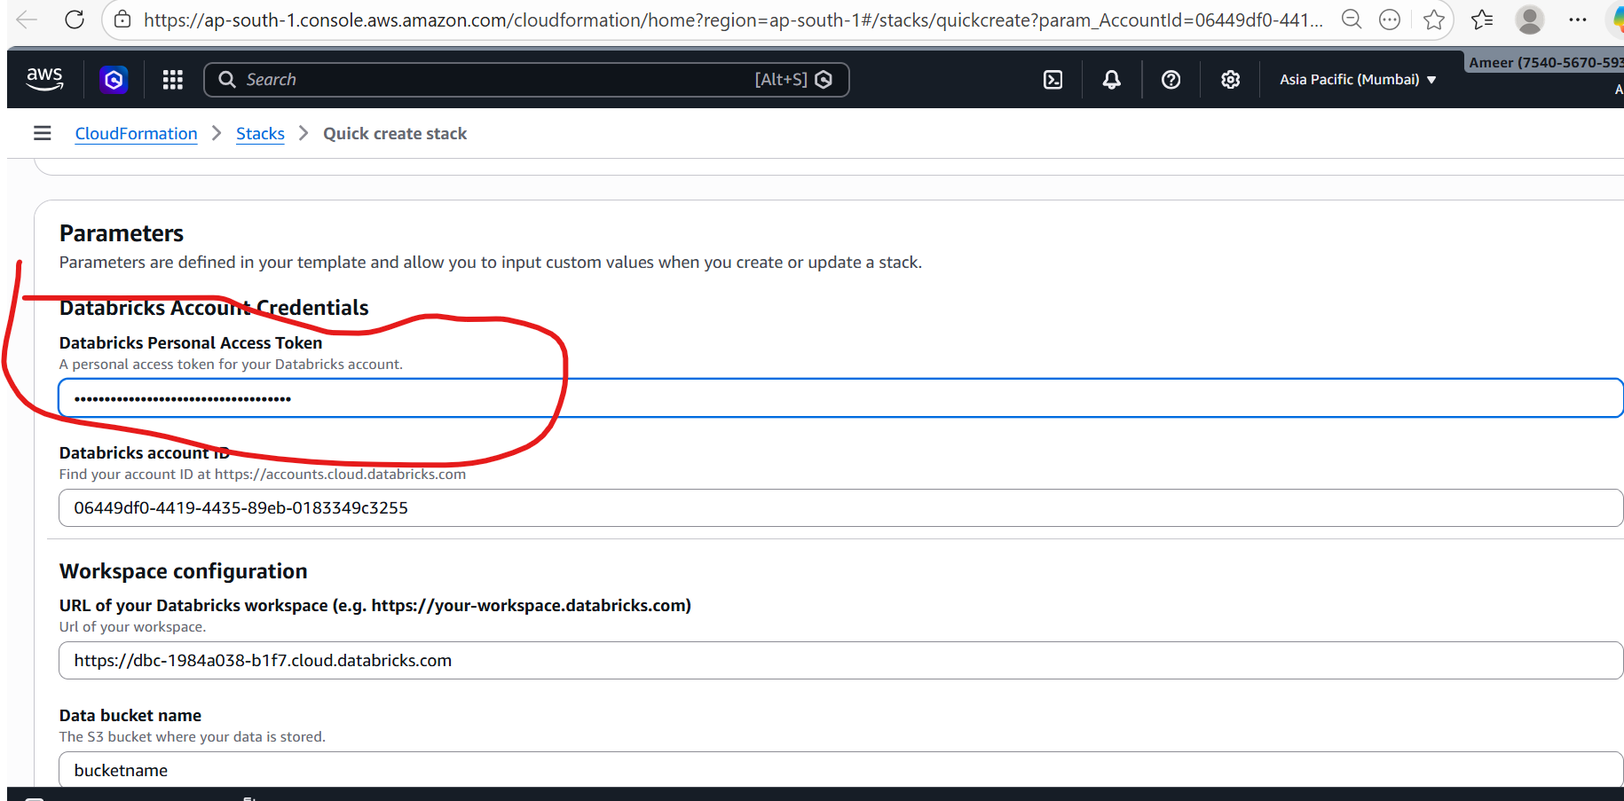
Click on launch quickstart and paste token

